Slide 1
A Case Study
Lecture 8

Slide 2
Agenda
The NextGen POS System
Use Case

Slide 3
Introduction
The case study is the NextGen point-of-sale (POS) system. In this apparently straightforward problem domain, we shall see that there are very interesting requirement and design problems to solve. In addition, it is a realistic problem; organizations really do write POS systems using object technologies.

Slide 4
Definition
A POS system is a computerized application used (in part) to record sales and handle payments; it is typically used in a retail store. It includes hardware components such as a computer and bar code scanner, and software to run the system. It interfaces to various service applications, such as a third-party tax calculator and inventory control. These systems must be relatively fault-tolerant; that is, even if remote services are temporarily unavailable (such as the inventory system), they must still be capable of capturing sales and handling at least cash payments (so that the business is not crippled).

Slide 5
Architectural Layers
A typical object-oriented information system is designed in terms of several architectural layers or subsystems
User Interface—graphical interface; windows.
Application Logic and Domain Objects—software objects representing domain concepts (for example, a software class named Sale) that fulfill application requirements.
Technical Services—general purpose objects and subsystems that provide supporting technical services, such as interfacing with a database or error logging. These services are usually application-independent and reusable across several systems.

Slide 6
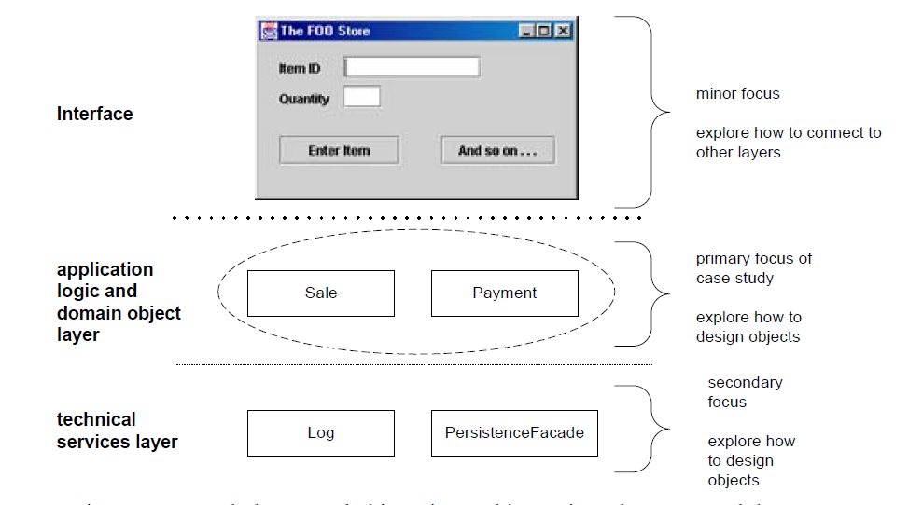

Slide 7
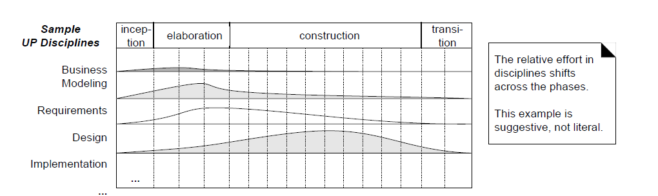

Slide 8
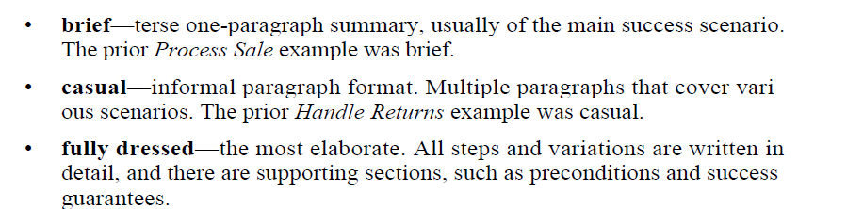
Different Formats

Slide 9
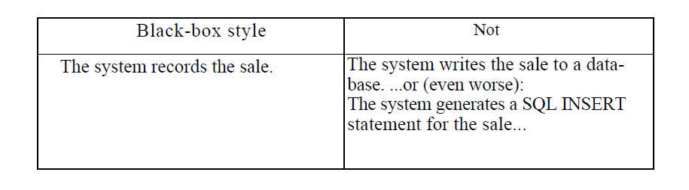
Only What not How?

Slide 10
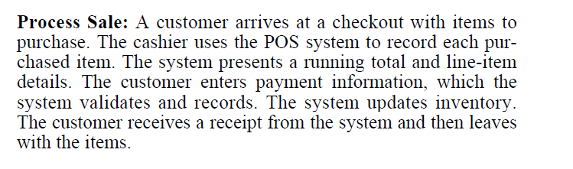
Brief Format

Slide 11
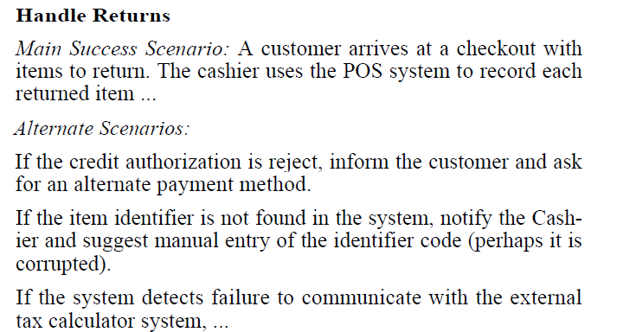
Casual Format

Slide 12
Fully Dressed
POS

Slide 13
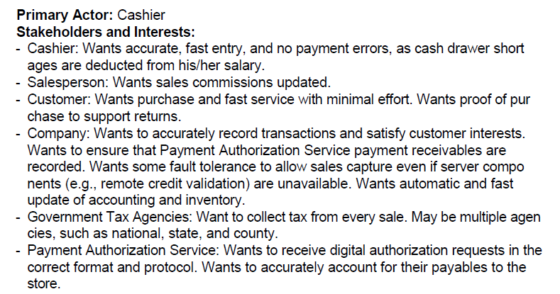

Slide 14
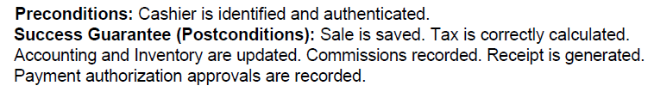
Preconditions and Postconditions

Slide 15
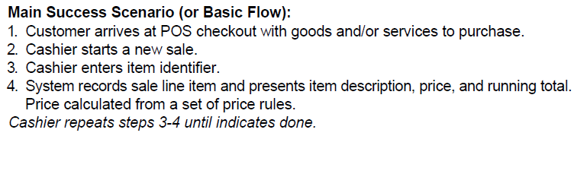
Main Success Scenario

Slide 16
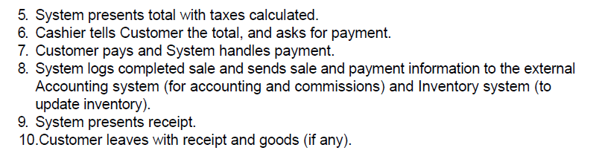
Main Success Scenario

Slide 17
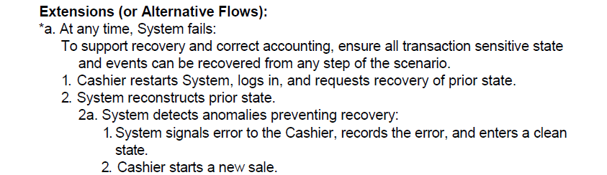
Extensions (or Alternate Flows)

Slide 18
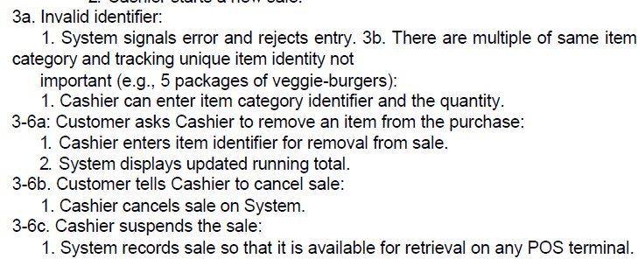
Extensions (or Alternate Flows)

Slide 19
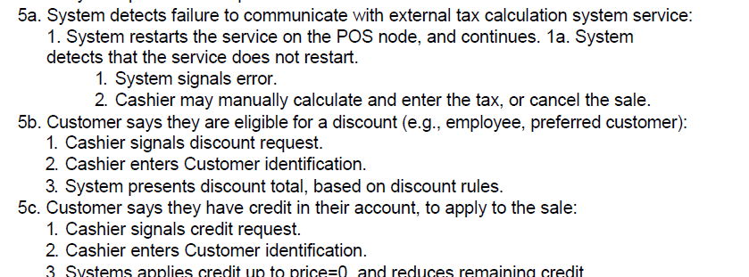
Extensions (or Alternate Flows)

Slide 20
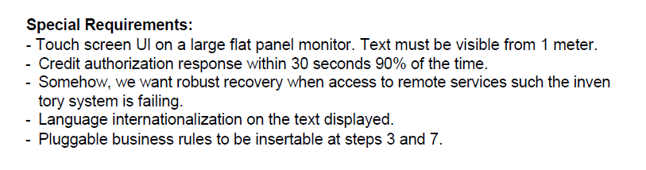
Non Functional Requirements

Slide 21
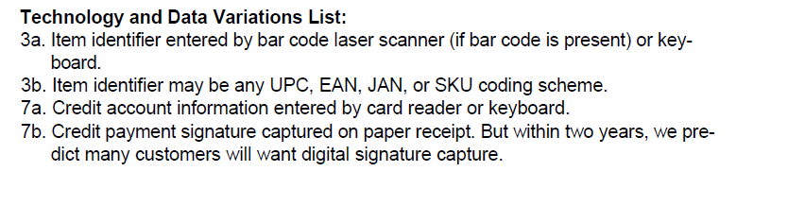

Slide 22
